Slide 1
Deep Learning With Horovod and TensorFlow Using GPUs and Docker Containers
Tom Phelan BlueData CTO / HPE Fellow
thomas.phelan@hpe.com, @tapbluedata

Slide 2
Agenda
Background. IOW, why AI is important
Deep Learning Application Requirements
Challenges
Solutions
Lessons Learned
Key Takeaways and Recommendations

Slide 3
Big Data
Big Data refers to data sets that are so voluminous and complex that traditional
data-processing application software are inadequate to deal with them.
Characterized by: volume, variety, velocity
Source: https://en.wikipedia.org/wiki/Big_Data

Slide 4
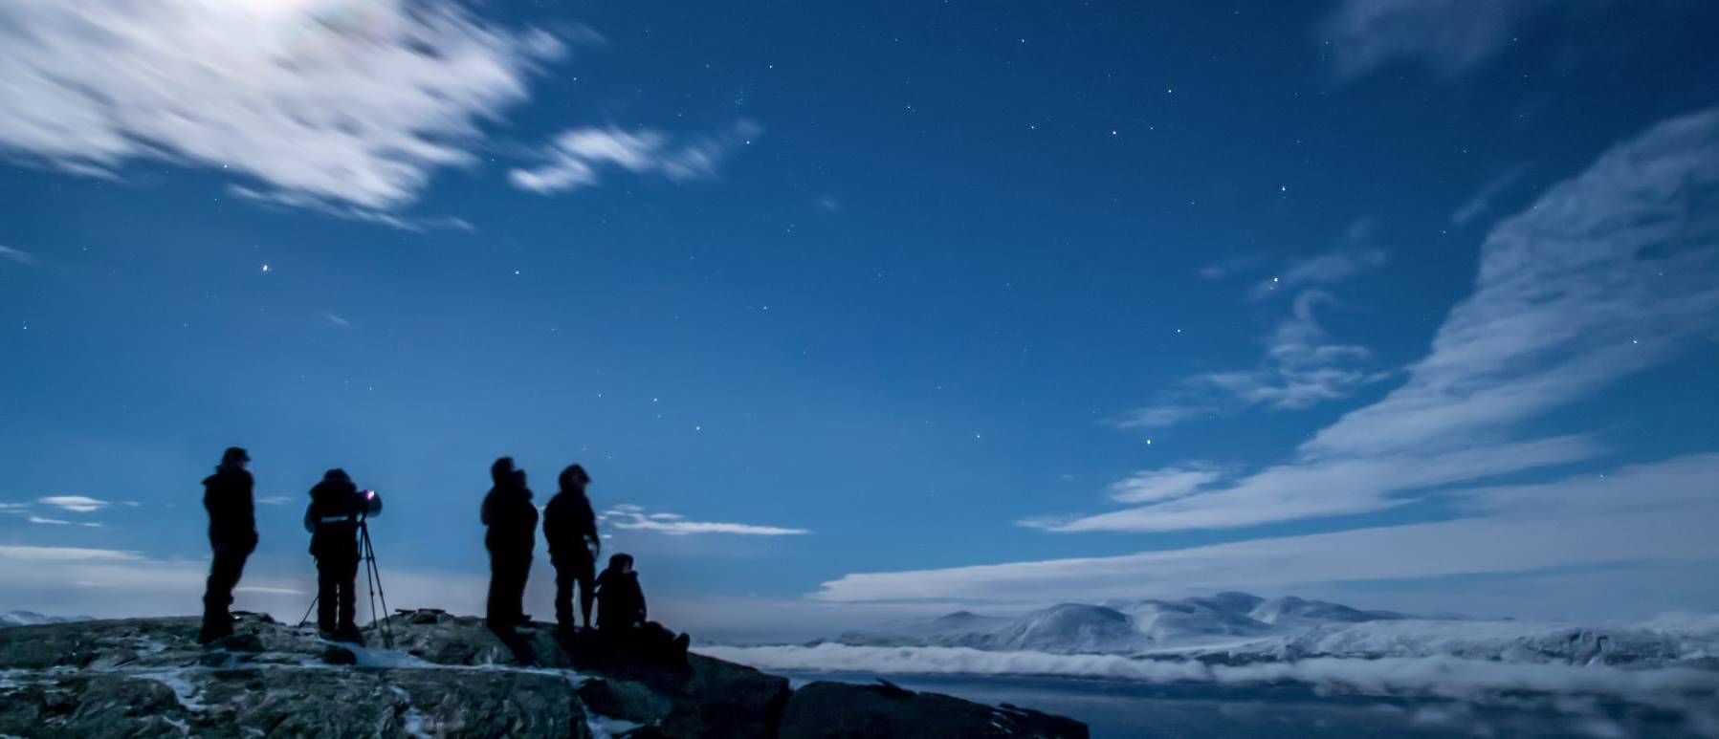
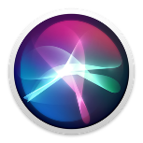
Let’s get grounded…what is AI?
Deep learning (DL)
Subset of ML, using deep artificial neural networks as models, inspired by the structure and function of the human brain.
Artificial intelligence (AI)
Mimics human behavior. Any technique that enables machines to solve a task in a way like humans do.
Deep learning
Example: Siri
Example:
Self-driving car
Machine learning (ML)
Algorithms that allow computers to learn from examples without being explicitly programmed.
Machine learning
Artificial intelligence
Example: Google Maps

Slide 5
Game Changing Innovation
Gartner 2019 CIO Agenda
Q: Which technology areas do you expect will be a game changer for your organization?
Answers:
#1 AI / Machine Learning
#2 Data Analytics
#3 Cloud
#4 Digital Transformation
Source: Gartner, Insights From the 2019 CIO Agenda Report, by Andy Rowsell-Jones, et al.

Slide 6
Why AI / ML / DL?
Everyone wants AI / ML / DL
and advanced analytics….
AI and advanced analytics represent
2 of the top 3 CIO priorities
….but face many challenges
AI and advanced analytics
infrastructure could constitute
15-20% of the market by 2021¹
Use cases
New roles, skill gaps
Culture and change
Data preparation
Legacy infrastructure
Enterprise AI adoption
2.7X growth in last 4 years²
¹ IDC. Goldman Sachs. HPE Corporate Strategy.2018
2 Gartner - “2019 CIO Survey: CIOs Have Awoken to the Importance of AI”

Slide 7
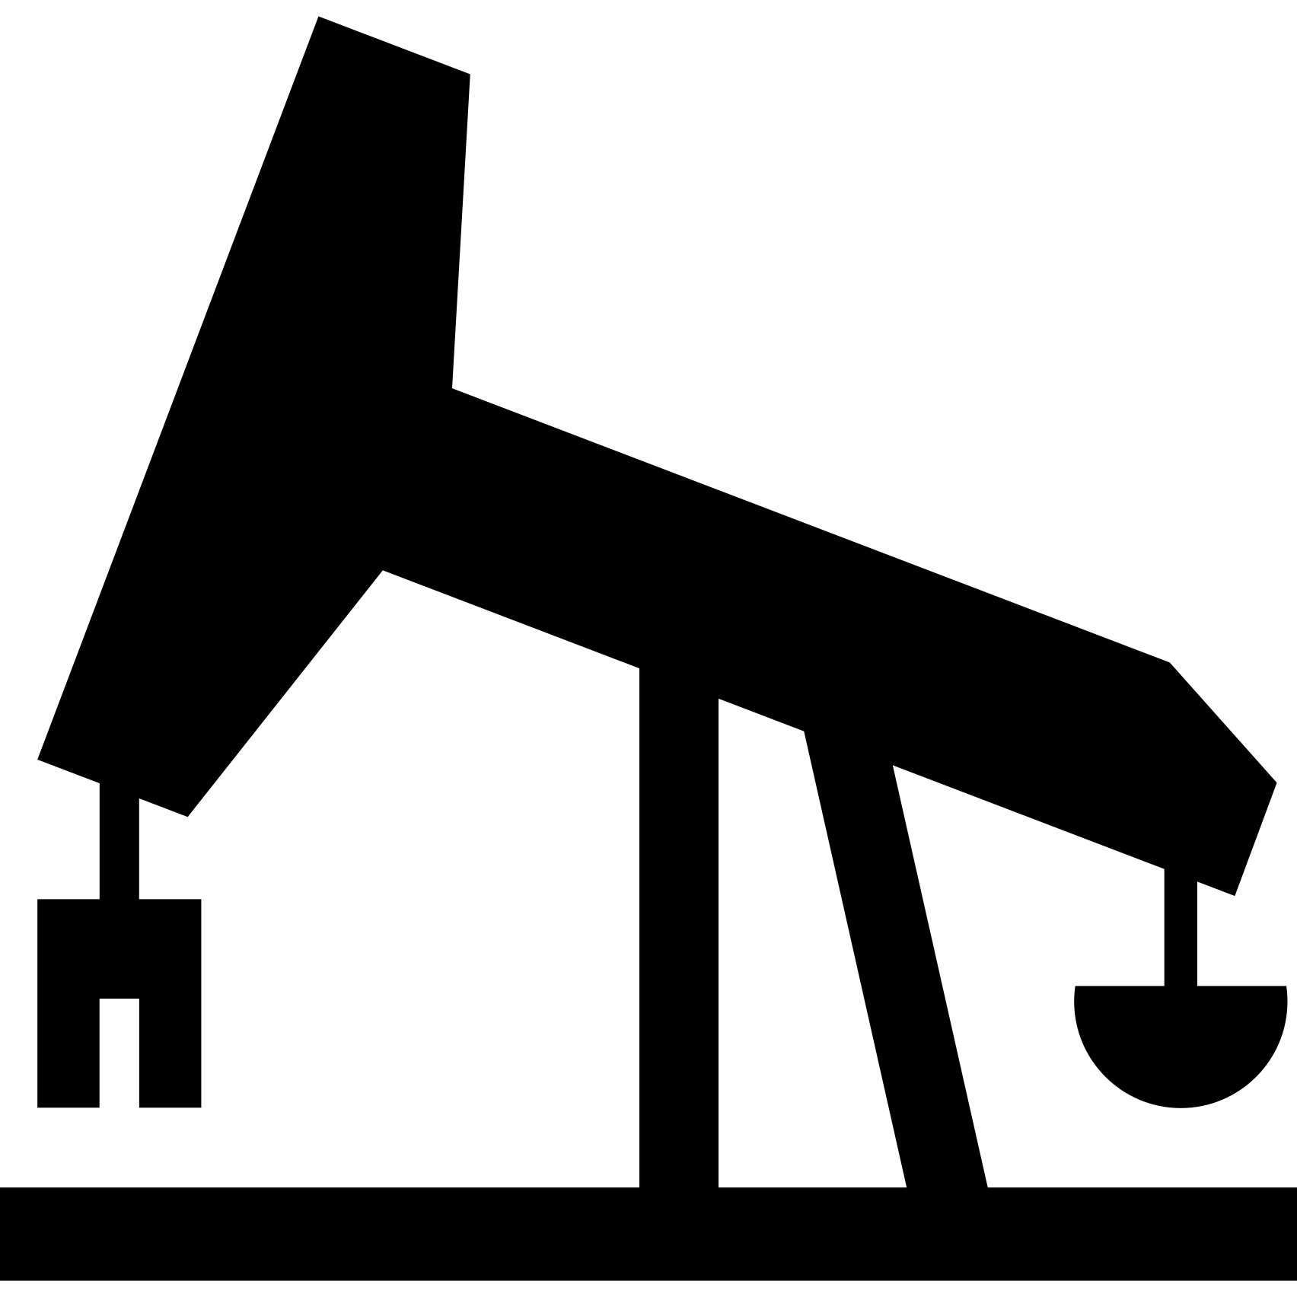
Enterprise Deep Learning Use Cases
Fraud Detection
Medical Diagnosis
Prediction
Credit Cards
Car Loans
Detection / Prediction of Cancer, Alzheimer’s, Pneumonia
Weather Forecast Gas & Oil Location
Buyer / Trader Action

Slide 8
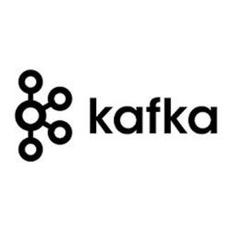
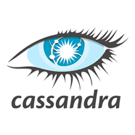
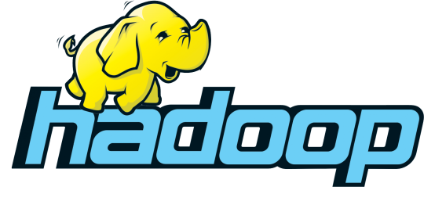
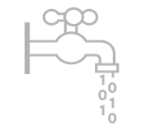
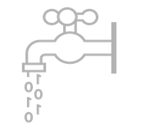
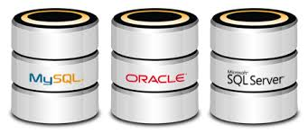
Sample Architecture & Applications
Electronic Health Record Systems
Kafka
Connect
Centralized Publisher
Subscriber Hub
Monitors / Devices
Local Store
Model Build
Publishers
Promotion
Results / Feedback
Database Access
Speed Layer
Model Score
Secure HDFS Data Lake

Slide 9
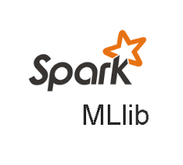
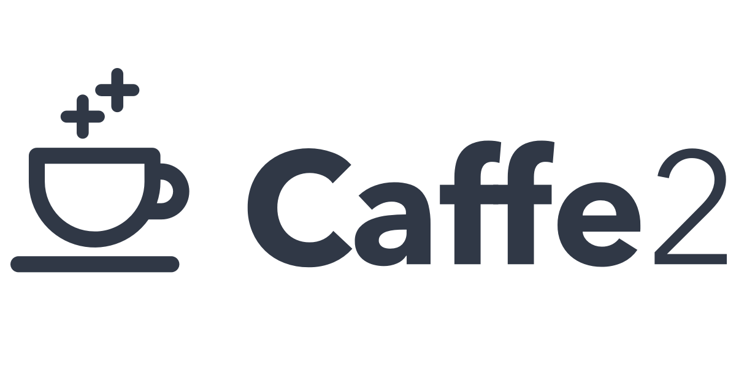
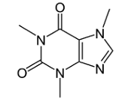
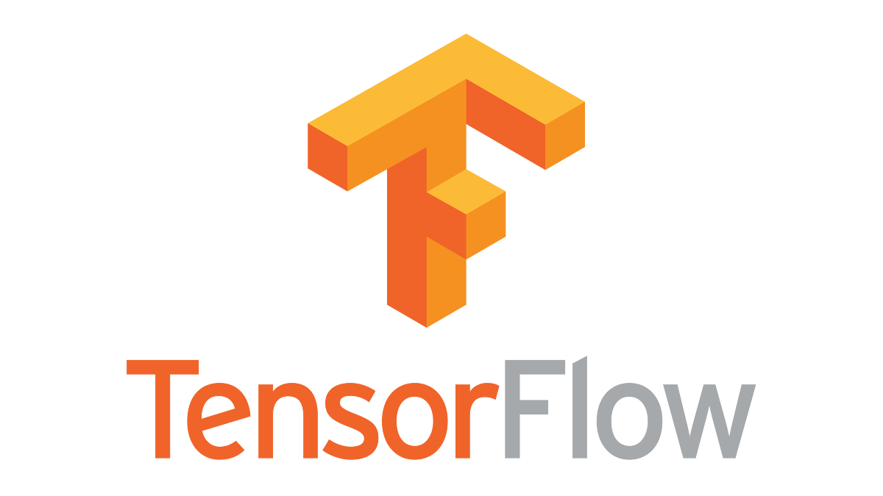
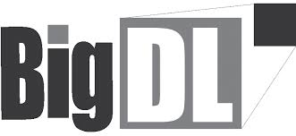
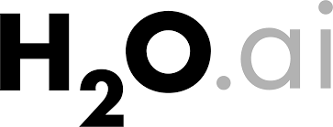
Popular Deep Learning Frameworks

Slide 10
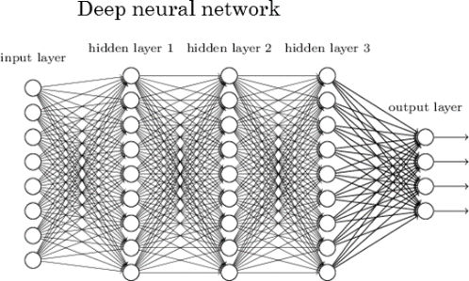
Deep Neural Network (DNN)
https://www.kdnuggets.com/wp-content/uploads/deep-neural-network.jpg

Slide 11
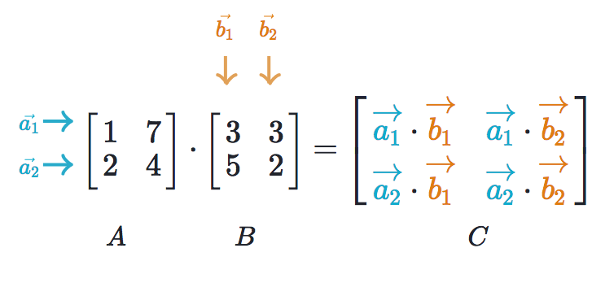
Matrix Multiplication
Source: https://www.khanacademy.org/math/precalculus/precalc-matrices/multiplying-matrices-by-matrices/a/multiplying-matrices

Slide 12
H/W Requirements
Q: What hardware is commonly used for deep learning and matrix multiplications?
A: Graphics Processing Units (aka GPUs)

Slide 13
S/W Requirements
Spark
TensorFlow
Horovod

Slide 14
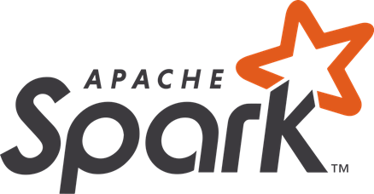
Spark
A unified analytics engine for large-scale data processing
Easy to use
Java, python, scala, R
Runs everywhere
Hadoop, mesos, kubernetes, standalone

Slide 15
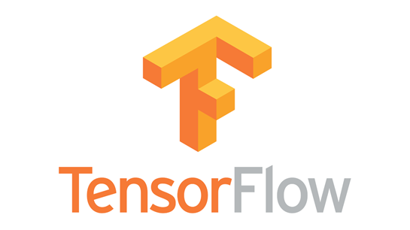
TensorFlow
An open source artificial intelligence library
Used for training models in parallel, on multiple devices, using GPUs
Builds large scale neural networks
Train quickly. Infer accurately.

Slide 16
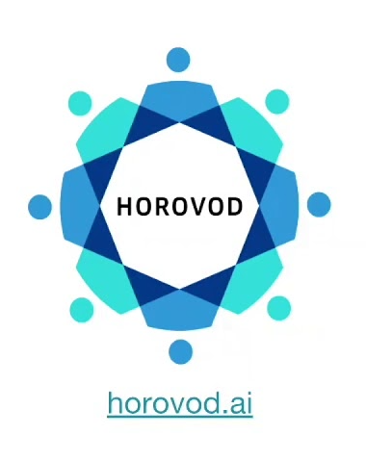
Horovod
An open source distributed deep learning training framework
Supports multiple applications
TensorFlow, PyTorch, Keras
Separates infrastructure capabilities from ML application
Installs on existing ML framework
pip install Horovod
Uses bandwidth optimal communication protocols
RDMA, InfiniBand if available

Slide 17
Distributed Training Framework
What?
Run multiple TensorFlow nodes in parallel
Why?
Improve the accuracy and speed of model training
How?
Model Parallelism
Different layers of the same model may be trained, on different nodes
Data Parallelism
Same model applied on different subset of data, on different nodes

Slide 18
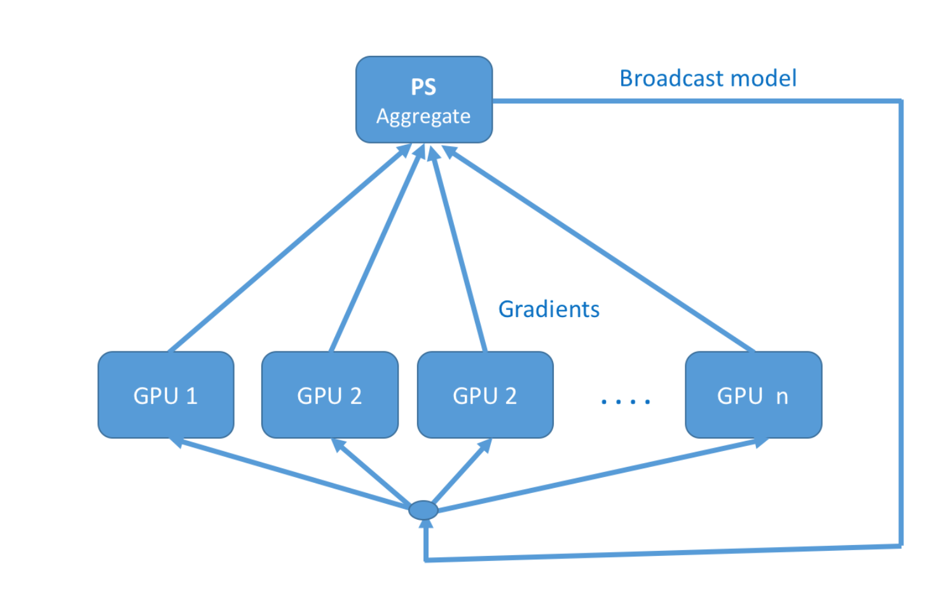
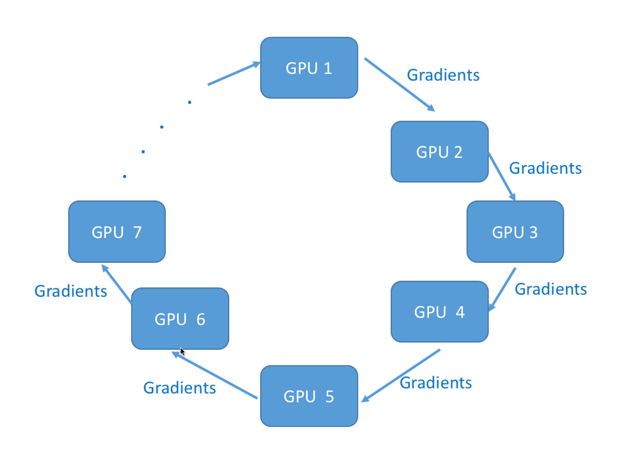
Distributed Training – Schemes
Data parallelism implementation
Needs to sync model parameters
Uses a centralized or decentralized scheme to communicate parameter update
Centralized schemes use a parameter server to communicate updates to parameters to nodes
Decentralized schemes use ring-allreduce to spread parameters across the nodes
Horovod is an open source framework developed by Uber that supports ring-allreduce
Based on https://towardsdatascience.com/distributed-tensorflow-using-horovod-6d572f8790c4

Slide 19
More Bits and Bobs
MPI for worker discovery
NVIDIA NCCL for managing traffic between servers during model training
Integration with security frameworks (AD/LDAP)
Horovod Specific Configuration Tuning
Fusion Threshold
Cycle Time

Slide 20
Running TensorFlow with Horovod

Slide 21
TensorFlow with Horovod
Open MPI invocation of Horovod
mpirun –np 4 /
--allow-run-as-root /
-d -H bluedata-302.bdlocal:2,bluedata-301.bdlocal:4 /
-bind-to none -map-by slot /
-x LD_LIBRARY_PATH /
-x PATH /
-mca pml ob1 /
-mca btl ^openib python tensorflow_word2vec_logs.py

Slide 22
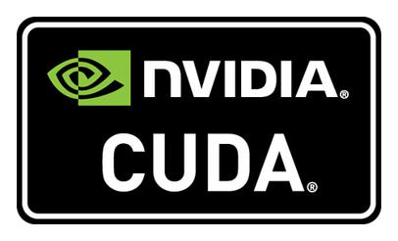
Fitting It All Together
Spark Driver
Horovod cluster
Spark Executor
Spark Executor
Spark Executor
Horovod cluster on multiple GPUs, containers, and machines
NCCL 2.3.7
NCCL 2.3.7
NCCL 2.3.7
MPI 3.1.3
MPI 3.1.3
MPI 3.1.3
TensorFlow 1.9
TensorFlow 1.9
TensorFlow 1.9
GPU / CUDA 9
GPU / CUDA 9
GPU / CUDA 9
Shared Data

Slide 23
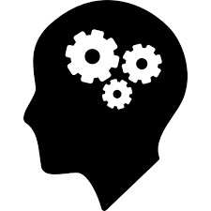
Wow!
This is complex
What it takes …

Slide 24
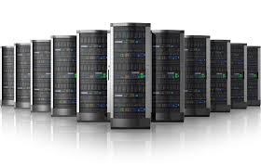
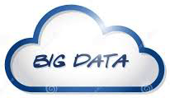
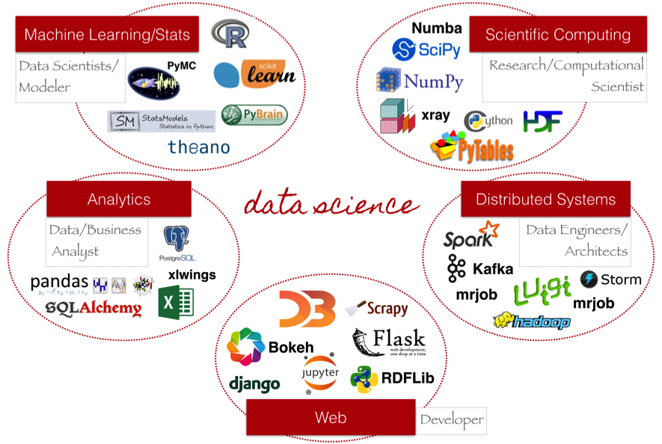
Architectural Challenges
Complexity:
Need repeatability and reproducibility across environments
Deploying multiple distributed platforms, libraries, applications, and versions
Sharing data:
Not duplicating data
Agility:
Scale up and down compute resources
Laptop
On-Prem Cluster
Off-Prem Cluster

Slide 25
Cost Challenges
How to run clusters on heterogeneous host hardware
CPUs and GPUs, including multiple GPU versions
How to maximize use of expensive hardware resources
How to minimize manual operations
Automating the cluster creation and deployment process
Creating reproducible clusters and reproducible results
Enabling on-demand provisioning and elasticity

Slide 26
Support and Security Challenges
How to support the latest versions of software
Deployment complexity and upgrades
Version compatibility
How to ensure enterprise-class security
Network, storage, user authentication, and access
Notes:
Often referred to as Day 2 challenges.

Slide 27
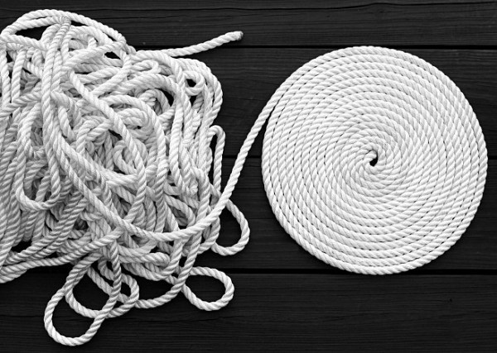
How To Bring Order Out of Chaos
https://medium.com/@samuelblack/your-chaos-to-my-order-8634ff0292ce

Slide 28
Faster ML / DL Deployment Time
Legacy Deployment
End User
Submit Job / Model
45 Days → ~10 Minutes
SSH / UI
Software
Management
Security (KDC, AD/LDAP)
User Access (SSH, SSL)
Add Services
Load Balancing
Port Mapping
~ x Days
New Deployment ?
Add / Configure Libraries
Onboard Users
Submit Job / Model
Init.d Configuration
Download / Install
SSH / UI
Hardware
Networking
Cluster Configuration
~10 Minutes
Storage
Security (KDC, AD/LDAP, SSL)
Operating System
Application Image
Physical Server
Docker

Slide 29
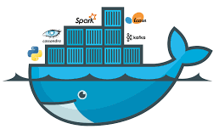
Technology Innovations
Simplify Deployments
Innovate Faster
Deploy Anywhere
Containerization allows the existence of multiple instances on a server.
Docker is software that
performs operating-system-level virtualization (aka containerization).
Source: https://en.wikipedia.org/wiki/docker_(software)

Slide 30
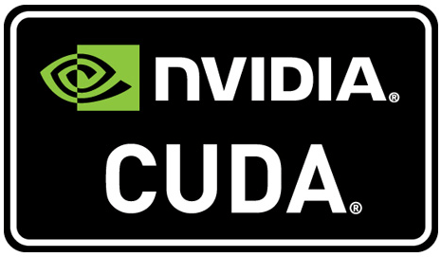
NVIDIA GPUs and CUDA
NVIDIA is the most common manufacturer of GPUs
CUDA is the software that allows applications to access the NVIDIA GPU hardware
CUDA library or toolkit
CUDA kernel device driver
GPU-hardware specific

Slide 31
A Brief History of Surfacing a GPU device into a Container
Use of docker –device command line option
Use of vendor specific Docker wrapper such as nvidia-docker (Introduced in 2016)
Use of NVIDIA Container Runtime (Introduced mid 2018)
Support for container runtimes other than Docker

Slide 32
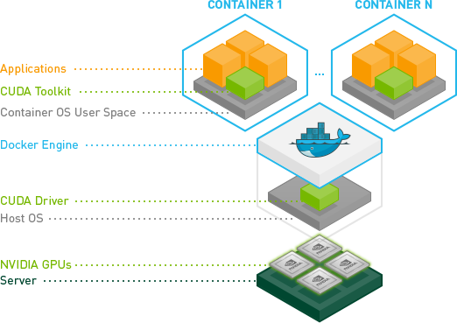
GPU Access from within a Container
Source: http://www.nvidia.com/object/docker-container.html

Slide 33
With HPE, Challenges Solved
Pre-built Docker images containing templated Spark, TensorFlow, and Horovod applications
Automated cluster creation and management of entire application stack
Intelligent placement on hosts surfacing required NVIDIA GPU h/w to the containers
Automatic injection of compatible NVIDIA CUDA libraries into container
Complete resource management (CPU, MEM, GPU, Storage)
All application access methods (UI, CLI, and API)
NFS mounts surfaced as local drives for data access
Support on premise and cloud infrastructure
Improve user experience with notebooks (Jupyter, etc)

Slide 34
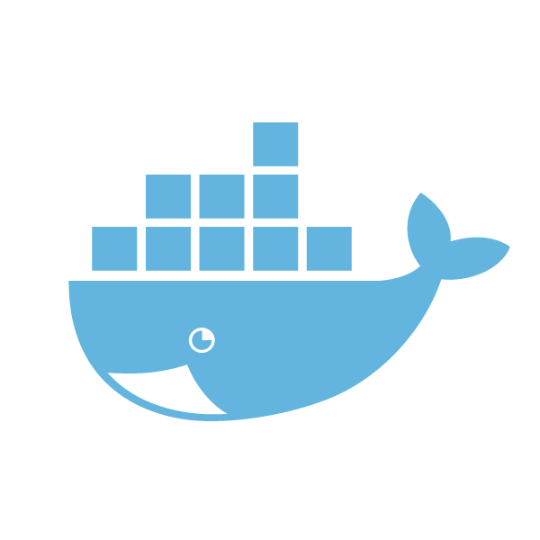
Fitting It All Together
Spark Driver
Horovod cluster
Spark Executor
Spark Executor
Spark Executor
Horovod cluster on multiple GPUs, containers, and machines
NCCL 2.3.7
NCCL 2.3.7
NCCL 2.3.7
MPI 3.1.3
MPI 3.1.3
MPI 3.1.3
TensorFlow 1.9
TensorFlow 1.9
TensorFlow 1.9
GPU / CUDA 9
GPU / CUDA 9
GPU / CUDA 9
Shared Data

Slide 35
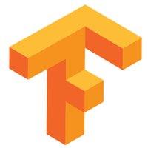
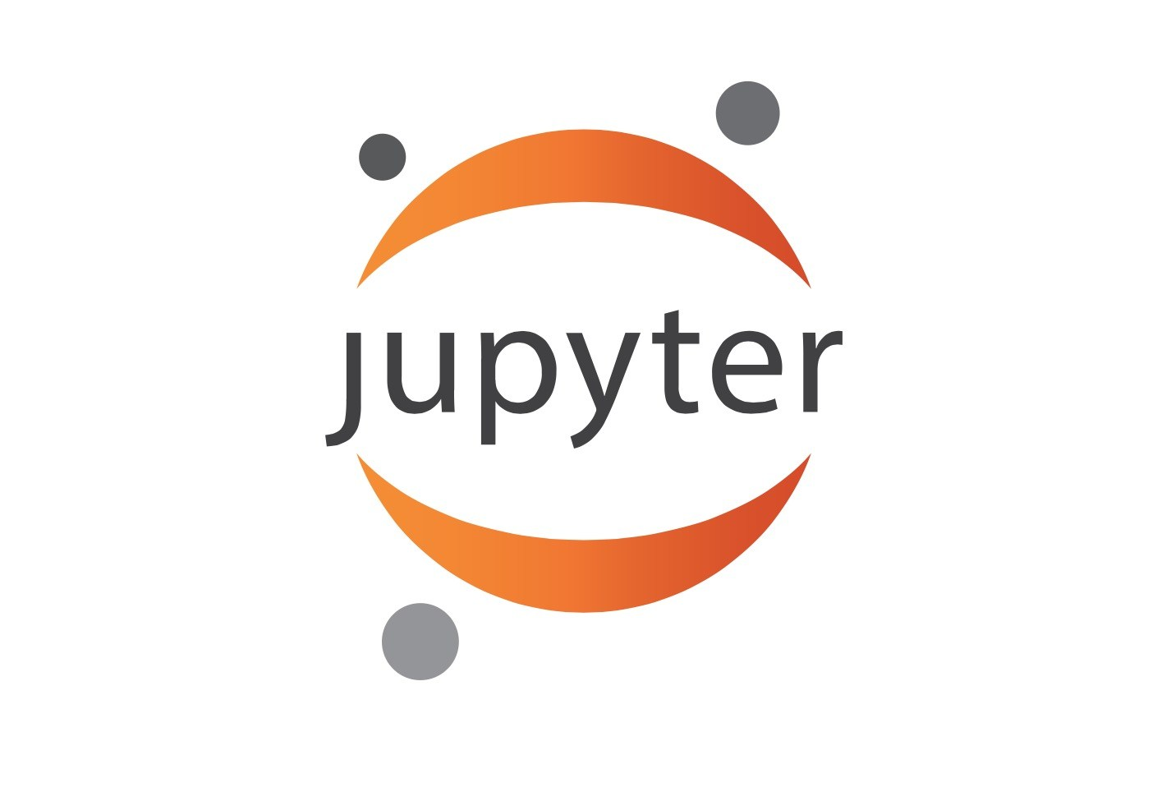
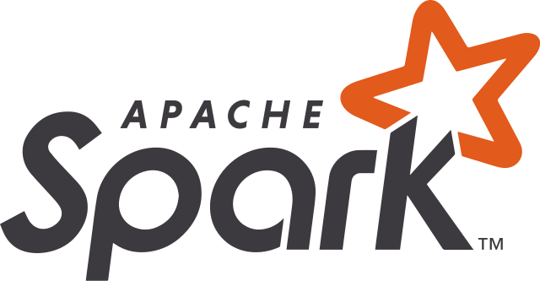
Implement Deep Learning Platform
Training
Production(Inference)
On-demand GPU-enabled clusters for deep learning
Submit jobs using notebooks, web UI, or API
Web-based SSH access for CLI jobs
Shared storage access with security
Cloud-ready architecture, using Docker containers
Quickly deploy sandbox nodes in minutes
Model save, load, share, and run
Compute Isolation
CUDA runtime
cuDNN
Mount GPU devices and
surface device drivers
Mount GPU devices and surface device drivers
DIY/K8S/DCOS/HPE
Containerized Big Data Infrastructure
GPU and
Non-GPU Hosts
Data Isolation
Data Isolation
HDFS Data Lake or NFS Enterprise Storage

Slide 36
Lessons Learned
Enterprises are using ML / DL today to solve difficult problems
Distributed ML / DL in the enterprise requires a complex stack, with multiple different tools
TensorFlow + Horovod is one popular option
The only constant is change … be prepared
Business needs, use cases, and tools will constantly evolve
We see CollectiveAllReduce replacing Horovod in some cases
Deployments are challenging, with many potential pitfalls
Containerization can deliver agility and cost saving benefits

Slide 37
Takeaways
Distributed deep learning applications can be deployed on Docker containers
GPU resources can be effectively shared between multiple applications
DevOps complexity can be hidden from the data scientist with self-service provisioning and automation
Data resources can be decoupled from compute resources in order to maximize platform flexibility and scalability without loss of performance

Slide 38
Recommendations
Start with a few key use cases to explore deep learning
Business needs, use cases, and tools will constantly evolve
Leverage a flexible, scalable, and elastic platform for success
Containerization can deliver agility and cost saving benefits
But there are significant challenges … without careful planning and execution DIY will likely be DOA

Slide 39
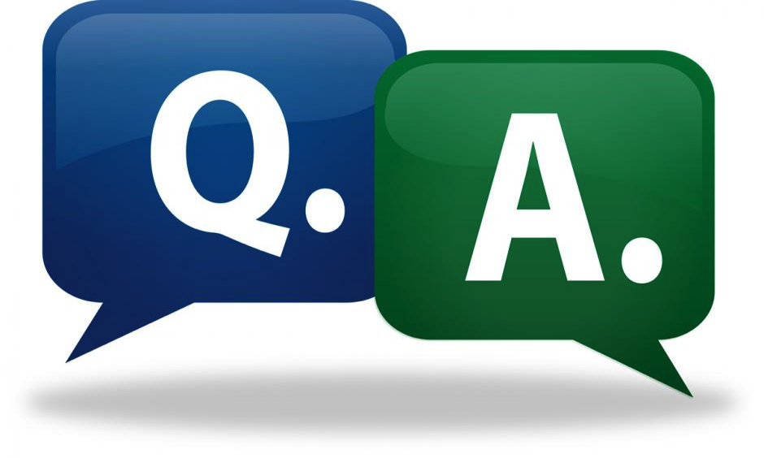
Tom Phelan
@tapbluedata

